Slide 1

Chatter

Slide 2
TEAM MEMBERS
Muhammad Taha Naveed ( 335929 )
Hamna Naveed ( 346470 )
Muhammad Danish ( 343448 )
Hafsa Imran ( 356959 )

Slide 3
Work Distribution
Hafsa Imran: Frontend
Hamna Naveed: Frontend
Muhammad Danish: Backend
Taha Naveed: Backend

Slide 4
Introduction
Chatter is a chat and networking platform for developers and communities.
Designed for collaboration among software development teams, users can create and join "rooms" for group or individual chat.
Key features
Real-time chat messages using sockets that establishes a connection between the client (the React app) and the server and exchange data in real-time.
Dynamic data – All data about users, rooms etc. are fetched from MongoDB documents.

Slide 5
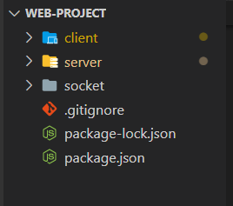
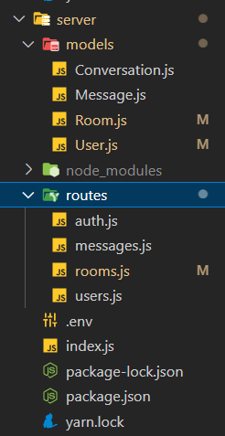
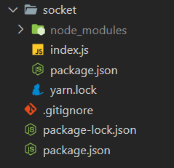
Directory structure

Slide 6
Front-end
React-hooks: React uses JSX, a syntax extension to JavaScript, to define how the UI should look. JSX is essentially a combination of JavaScript and HTML, so it allows you to define UI elements using a familiar syntax.
Socket.io-client: Client-side library for real-time communication through sockets.
Bcrypt: A password hashing function that is designed to be secure and resistant to attacks such as brute-force and dictionary attacks.
ContextAPI: Share values between components without the use of props.
React-strap: Bootstrap for react application
Axios: Popular JS library used to make API calls to back-end.

Slide 7
Back-end
Express: Express is a popular JavaScript library that is used to build web applications and APIs. It provides a simple, lightweight framework for building server-side applications with Node.js.
Node: Node.js is a JavaScript runtime that allows you to run JavaScript on the server-side, outside of a web browser.
Socket.io (socket server): Server-side library for real-time communication through sockets.
Bcrypt: A password hashing function that is designed to be secure and resistant to attacks such as brute-force and dictionary attacks.
Cors: CORS is a mechanism that allows a web page to make requests to a server from a different domain than the one that served the web page. This is important because web browsers enforce a security policy called the same-origin policy, which prevents web pages from making requests to a server on a different domain for security reasons.

Slide 8
API
We have exposed the following API to connect with database.
AUTHENTICATION
POST
/api/register
/api/login
MESSAGES
POST
/api/send/:roomId/:userId
GET
/api/all/:roomId

Slide 9
API
ROOMS
POST
/api/create/:userId
PUT
/api/join/:roomId/:userId
/api/leave/:roomId/:userId
/api/get/:roomId
GET
/api/public
/api/users/:roomId
USERS
PUT
/api/:id
DELETE
/api/:id
GET
/rooms/:userId
/api/users/:roomId

